Slide 1
CSE 219: Digital Logic & Computer Design
Tamanna Haque Nipa
Assistant Professor
Dept. of CSE
Stamford University Bangladesh

Slide 2
Binary Codes
In the coding, when numbers, letters or words are represented by a specific group of symbols, it is said that the number, letter or word is being encoded. The group of symbols is called as a code. The digital data is represented, stored and transmitted as group of binary bits. This group is also called as binary code.
Advantages of Binary Code
Suitable for the computer applications.
Suitable for the digital communications.
Make the analysis and designing of digital circuits
Since only 0 & 1 are being used, implementation becomes easy.

Slide 3

Classification of binary codes
The codes are broadly categorized into following four categories.
On the basis of weight
Weighted Codes
Non-Weighted Codes
Excess-3 code
Gray Code
Binary Coded Decimal Code
Alphanumeric Codes
Error Codes
Error Detecting Codes
Error Correcting Codes

Slide 4
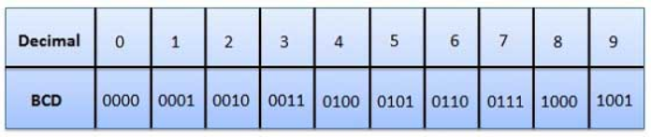
Binary Coded Decimal (BCD) code
In this code each decimal digit is represented by a 4-bit binary number. BCD is a way to express each of the decimal digits with a binary code. With four bits we can represent sixteen numbers (0000 to 1111). But in BCD code only first ten of these are used (0000 to 1001). The remaining six code combinations i.e. 1010 to 1111 are invalid in BCD.

Slide 5
Binary Coded Decimal (BCD) code
Advantages of BCD Codes
It is very similar to decimal system.
We need to remember binary equivalent of decimal numbers 0 to 9 only.
Disadvantages of BCD Codes
The addition and subtraction of BCD have different rules.
The BCD arithmetic is little more complicated.
BCD needs more number of bits than binary to represent the decimal number. So BCD is less efficient than binary.

Slide 6

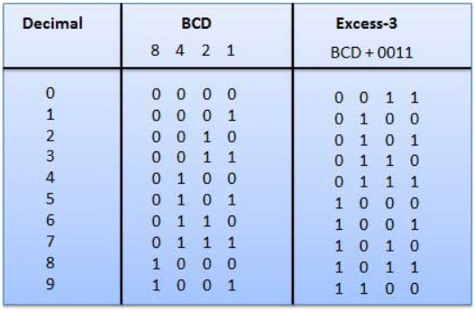
Excess-3 code (XS-3)
The Excess-3 code words are derived from the 8421 BCD code words adding (0011)₂ or (3)₁₀ to each code word in 8421.
CAT
ECV
Exercise: Find Excess-5 code.

Slide 7
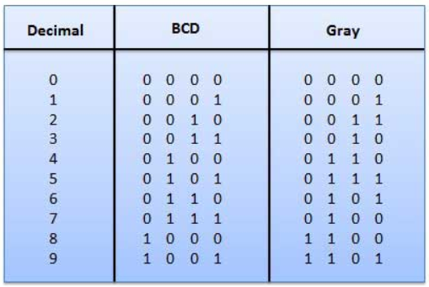
Gray Code (Cyclic Code, Reflected Binary Code (RBC), Reflected Binary (RB) or Grey code)
It has a very special feature that, only one bit will change each time the decimal number is incremented. As only one bit changes at a time, the gray code is called as a unit distance code. Gray code cannot be used for arithmetic operation.

Slide 8
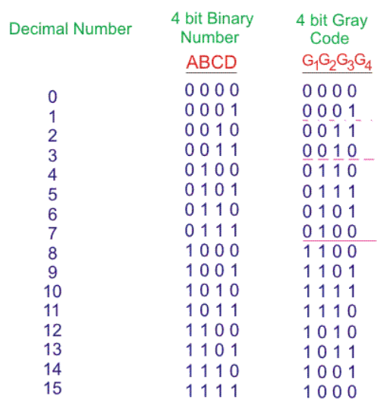
Gray Code

Slide 9
Code Conversion - Binary to Gray (3 bit)
Truth Table:
Equation
Binary Code
A | B | C
0 | 0 | 0
0 | 0 | 1
0 | 1 | 0
0 | 1 | 1
1 | 0 | 0
1 | 0 | 1
1 | 1 | 0
1 | 1 | 1
Gray Code
X | Y | Z
0 | 0 | 0
0 | 0 | 1
0 | 1 | 1
0 | 1 | 0
1 | 1 | 0
1 | 1 | 1
1 | 0 | 1
1 | 0 | 0
X=AB⁰C⁰ +AB⁰C + ABC⁰ +ABC
=AB⁰(C⁰ + C) + AB(C⁰ + C)
=AB⁰ + AB
=A(B⁰ + B) =A
Y=A⁰BC⁰ +A⁰BC + AB⁰C⁰ +AB⁰C
=A⁰B(C⁰ + C) + AB⁰(C⁰ + C)
=A⁰B + AB⁰
=A ⊕ B
Z=A⁰B⁰C + A⁰BC⁰ +AB⁰C + ABC⁰
=A⁰B⁰C +AB⁰C + A⁰BC⁰ + ABC⁰
= B⁰C(A⁰ +A) + BC⁰ (A⁰+ A)
= B⁰C + BC⁰
= B ⊕ C

Slide 10

Code Conversion - Binary to Gray (3 bit)
Truth Table:
Equation
Binary Code
A | B | C
0 | 0 | 0
0 | 0 | 1
0 | 1 | 0
0 | 1 | 1
1 | 0 | 0
1 | 0 | 1
1 | 1 | 0
1 | 1 | 1
Gray Code
X | Y | Z
0 | 0 | 0
0 | 0 | 1
0 | 1 | 1
0 | 1 | 0
1 | 1 | 0
1 | 1 | 1
1 | 0 | 1
1 | 0 | 0
X=A
Y=A ⊕ B
Z= B ⊕ C
A
B
C
X
Y
Z

Slide 11
Code Conversion – Gray to Binary (3 bit)
Truth Table:
Equation
Gray Code
X | Y | Z
0 | 0 | 0
0 | 0 | 1
0 | 1 | 1
0 | 1 | 0
1 | 1 | 0
1 | 1 | 1
1 | 0 | 1
1 | 0 | 0
Binary Code
A | B | C
0 | 0 | 0
0 | 0 | 1
0 | 1 | 0
0 | 1 | 1
1 | 0 | 0
1 | 0 | 1
1 | 1 | 0
1 | 1 | 1
A=XYZ⁰ +XYZ + XY⁰Z +X⁰YZ
=XY(Z⁰ + Z) + Z(XY⁰ + X⁰Y)
=XY + Z(X ⊕ Y)
B=X⁰YZ +X⁰YZ⁰ + XYZ +X⁰YZ
=X⁰Y(Z + Z⁰ ) + YZ (X+X⁰)
=X⁰Y + YZ = Y(X⁰+Z)
C=X⁰Y⁰Z +X⁰YZ⁰ + XYZ +X⁰YZ
=X⁰(Y⁰Z +YZ⁰) + YZ (X+X⁰)
=X⁰(Y ⊕ Z) + YZ

Slide 12



Code Conversion – Gray to Binary (3 bit)
Truth Table:
X
Y
Z
Gray Code
X | Y | Z
0 | 0 | 0
0 | 0 | 1
0 | 1 | 1
0 | 1 | 0
1 | 1 | 0
1 | 1 | 1
1 | 0 | 1
1 | 0 | 0
Binary Code
A | B | C
0 | 0 | 0
0 | 0 | 1
0 | 1 | 0
0 | 1 | 1
1 | 0 | 0
1 | 0 | 1
1 | 1 | 0
1 | 1 | 1
X
Y
Z
Equation
A=XY + Z(X ⊕ Y)
B= Y(X⁰+Z)
C =X⁰(Y ⊕ Z) + YZ

Slide 13
Code Conversion - Binary to Excess-3 (3 bit)
Binary Code
A | B | C
0 | 0 | 0
0 | 0 | 1
0 | 1 | 0
0 | 1 | 1
1 | 0 | 0
1 | 0 | 1
1 | 1 | 0
1 | 1 | 1
 | Excess-3 Code
W | X | Y | Z
0 | 0 | 1 | 1
0 | 1 | 0 | 0
0 | 1 | 0 | 1
0 | 1 | 1 | 0
0 | 1 | 1 | 1
1 | 0 | 0 | 0
1 | 0 | 0 | 1
1 | 0 | 1 | 0
Equation and Diagram
Do Yourself

Slide 14
Code Conversion
Excess-3 to Binary
BCD to Gray
BCD to Excess-3
Gray to BCD
Excess-3 to BCD

